Slide 1
AIT 622 - Group 3
IoT - Application in Healthcare
Ayushi Tiwari
Harshitha Mallampati
Neha Lad
Yohannes Mengistu

Slide 2
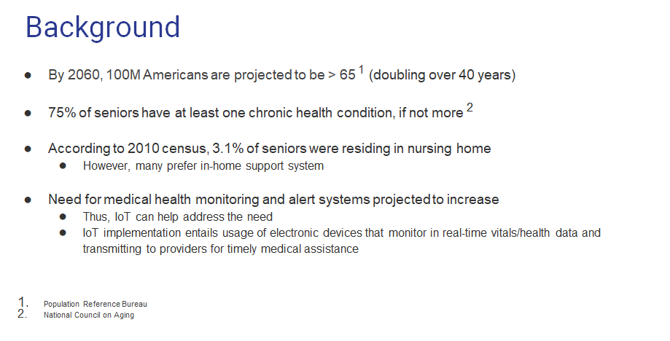

Slide 3
Business Scenario and Scope
Target population:
Geriatric patients with no professional care 24/7, and no support network
Worst-case Scenario:
Stay home alone and have an immediate medical need due to a fall, flu, heart or breathing problems that might lead to an injury or death, otherwise avoidable
Technology Solution:
IoT devices monitoring real-time vital signs: BP, BT, HR, RR
Alert stakeholders for timely response, if need exists

Slide 4
Purpose
Capitalize on the advances in IoT technologies to address issues in patient healthcare delivery systems thereby effecting favorable outcomes for geriatric patients.

Slide 5
Project Description
Monitor
Patients’ real-time vital signs and health status.
Act
Develop effective emergency response mechanism for stakeholders to coordinate their efforts in case of an emergency.
Analyze
Real-time analysis to identify need for emergency medical attention, dashboard to visualize multi-parameter analysis.

Slide 6
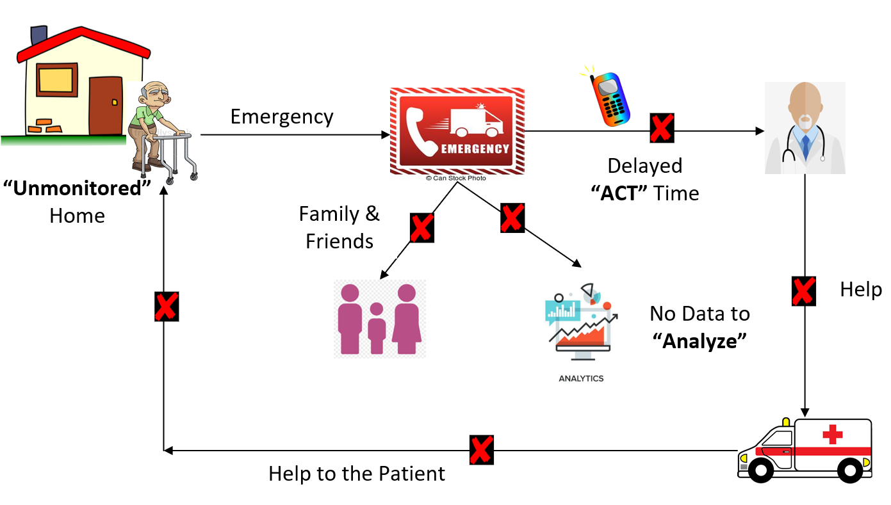
Current Environment: Problems

Slide 7
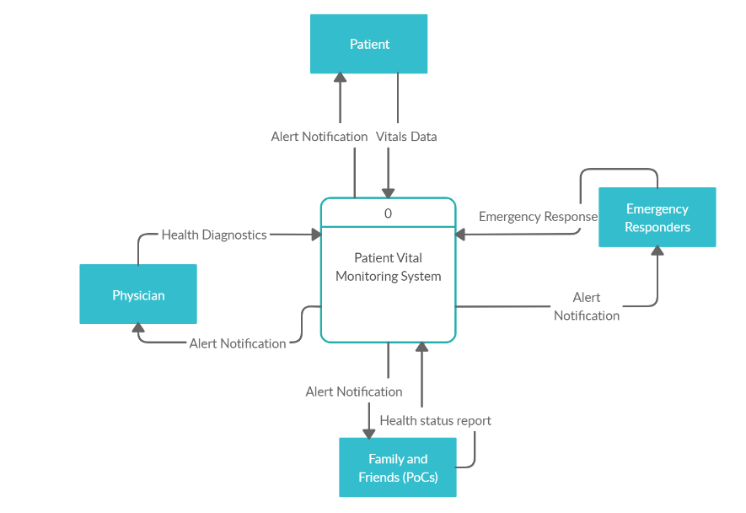
Proposed System Interface (Context DFD)

Slide 8
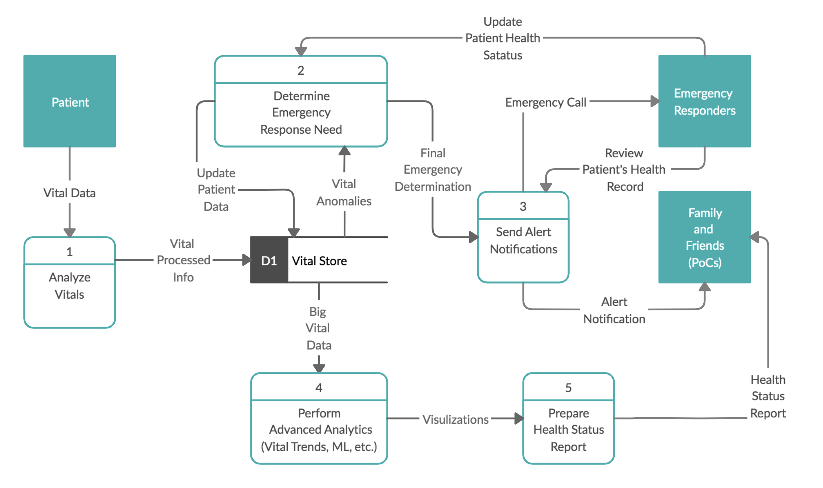
Proposed System’s Major Processes (Level 0 DFD)

Slide 9
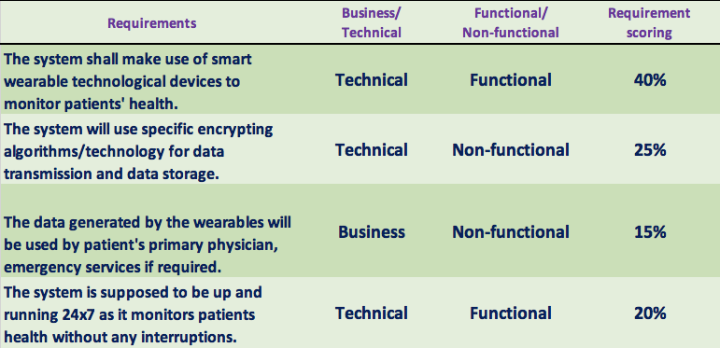
Requirements

Slide 10
Alternative’s Recommendation
Analysis of Alternative Results |  | Alternatives
 |  | Monitor Act Analyze Cloud Infrastructure |  | In– House Development |  | Outsource
Criteria | Weight(%) | Rating | Score | Rating | Score | Rating | Score
Cost | 30% | 4 | 0.9 | 1 | 0.3 | 2 | 0.6
Ease of Use | 20% | 3 | 0.8 | 4 | 0.8 | 2 | 0.4
Maintenance & Upgrades | 20% | 4 | 0.8 | 4 | 0.8 | 3 | 0.6
Quality | 30% | 4 | 1.2 | 5 | 1.5 | 2 | 0.6
Total | 100% |  | 3.7 |  | 3.4 |  | 2.2

Slide 11
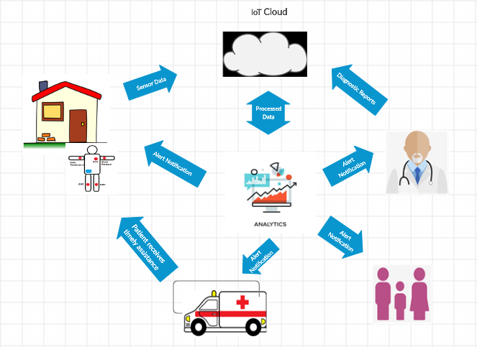
Proposed Environment Solution
Notes:
Wearable IoT devices attached to geriatric patients transmitting sensory data
IoT routers to couple sensory data, sort, and route the data to analytics hub
Real-time data analytics and anomaly detection
Coordination of emergency responses, if any exists
Tracking of historical trends, data mining, and identification of additional business opportunities and patient safety advocacy

Slide 12
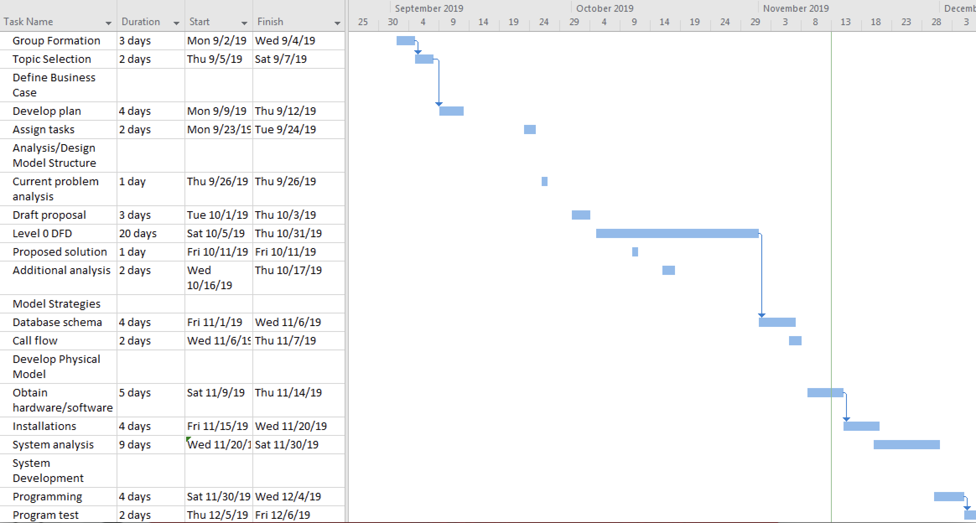
Project Schedule

Slide 13
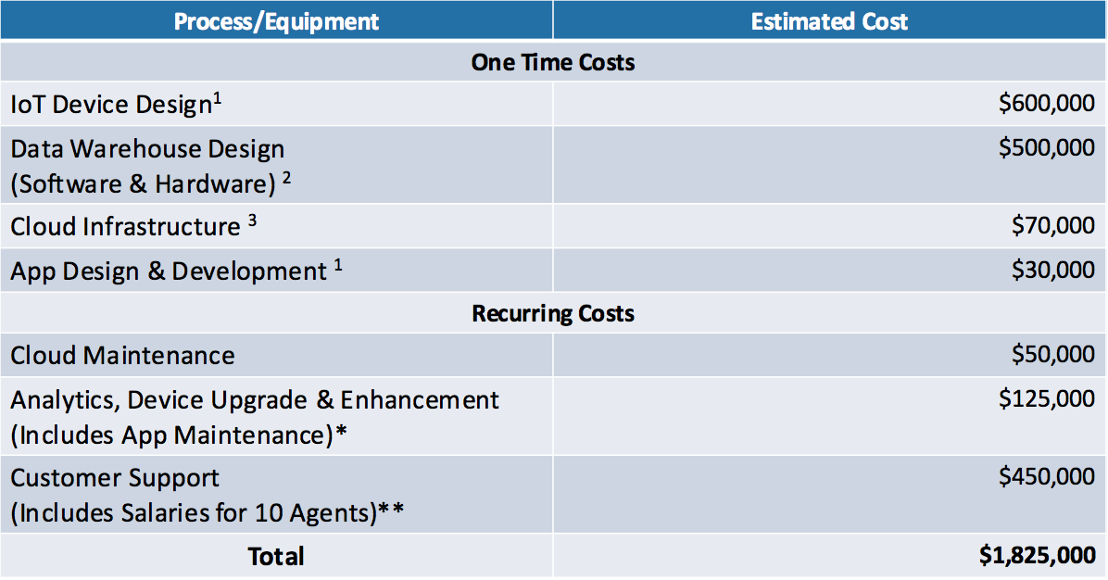
Estimated Costs
Notes:
¹ https://r-stylelab.com/company/blog/iot/internet-of-things-how-much-does-it-cost-to-build-iot-solution
² https://www.cooladata.com/cost-of-building-a-data-warehouse/
³ https://www.imagineiti.com/the-cloud/costs-cloud/
* Assuming Average Maintenance Cost is 25% of the Initial Development Cost
**Glassdoor Average Salary

Slide 14
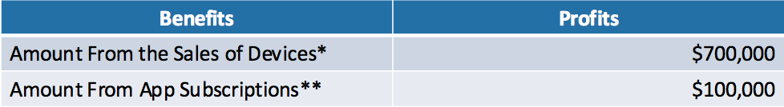
Estimated Benefits
Tangible Benefits:
The vital Signs Monitoring Wearables market is expected to grow by 5.8% each year.^
The reaction time is estimated to be reduced by an average of 53.3%. ^^
Intangible Benefits
Increased quality of life for Geriatric Patients.
Making effective health care a possibility for patients in remote areas.
Reducing errors and creating automated workflows.
Notes:
^ https://www.alliedmarketresearch.com/vital-signs-monitoring-market
^^ https://dzone.com/articles/iot-for-healthcare-medelliacuten-health-tech-compa
* Assuming the Sale Price of Each Device is $700 and there are a 1000 Devices sold in the first year - https://www.reuters.com/brandfeatures/venture-capital/article?id=37699
** App has a maintenance fee of $100 for an Annual Subscription

Slide 15
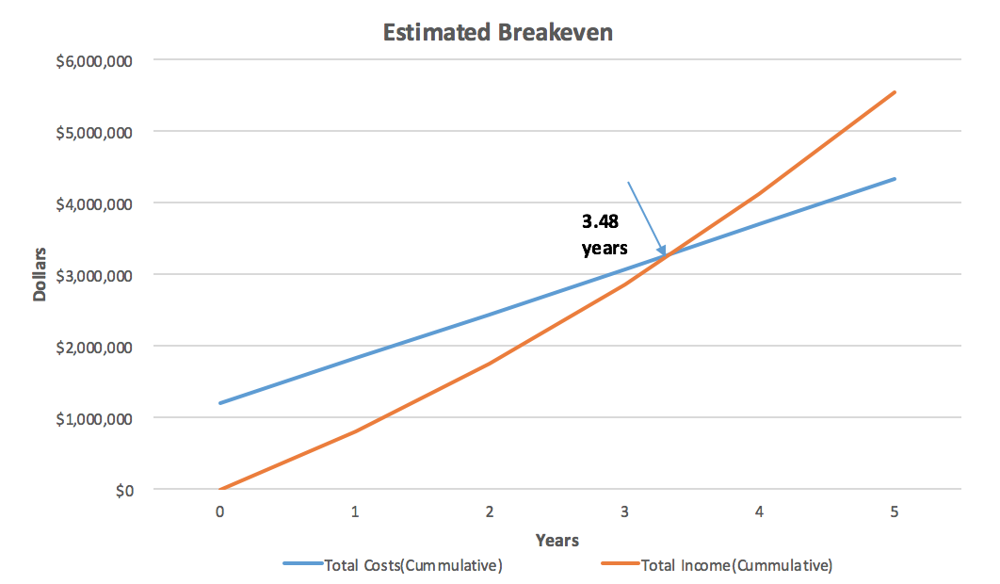
Estimated Breakeven

Slide 16
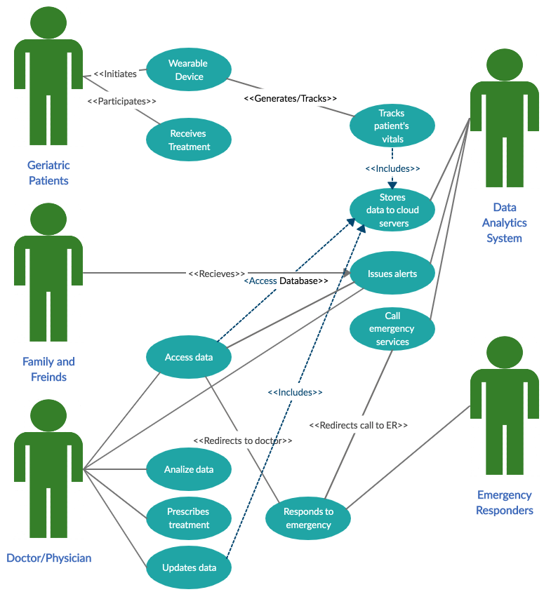
Use Cases

Slide 17
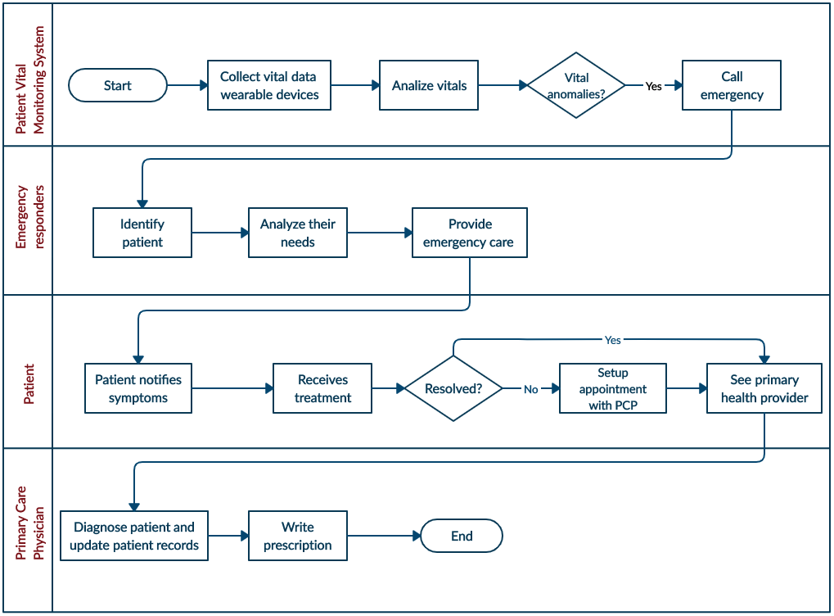

Slide 18
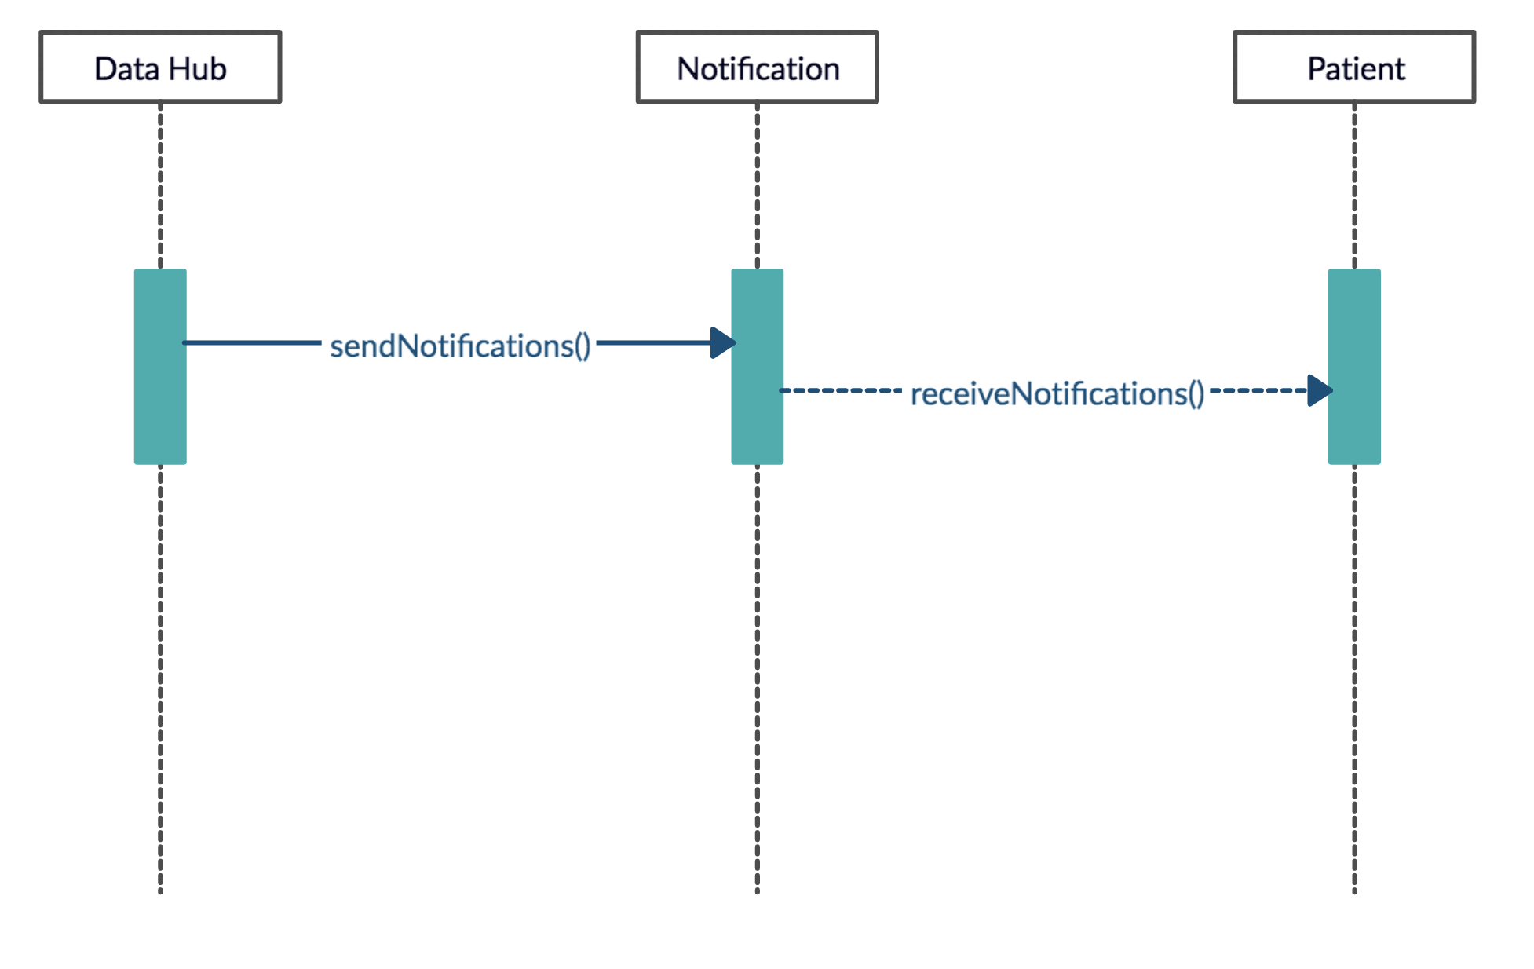
Technical Sequencing of Functions
Use Case - Generate Alert Notification

Slide 19
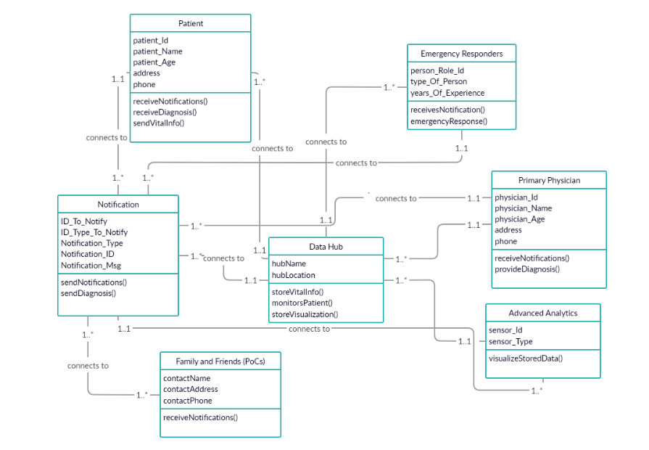
Data Model
Notes:
Ayushi working on this.
@ looks great, I will look at it. See also my draft of Data Model next page.
Update 11/7/2019 - Professor’s Feedback incorporated.

Slide 20
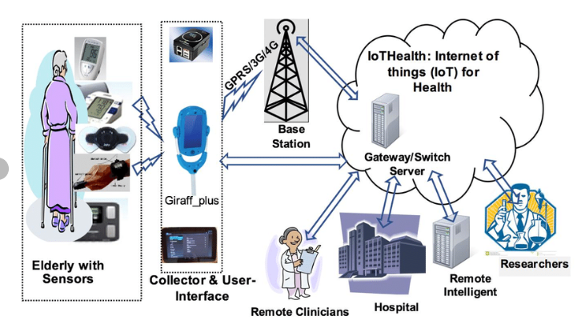
Prototype

Slide 21
Conclusion
The simple IoT device with specific functionality is proven to be effective technology solution to save lives, reduce burden in the health care system, and create value for the business owners, family and friends.
The solution is also extensible to create more business opportunities and add more functionalities that integrate seamlessly.
The IoT solution is also applicable as a transfer learning to other technology domains.
Finally, it was a good learning experience and case study for future educational or real-world projects.

Slide 22
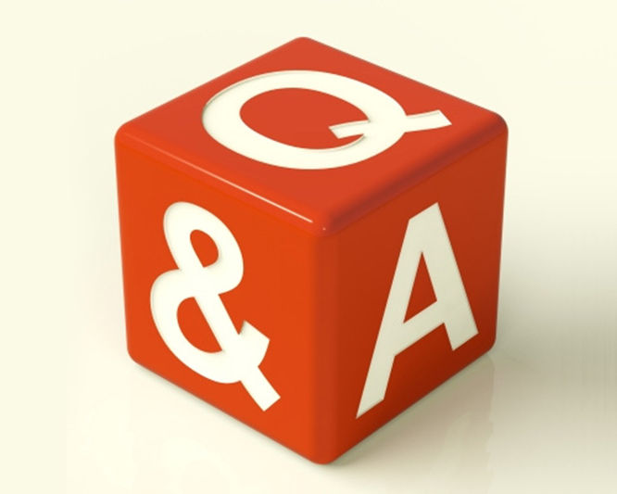
Q&A

Slide 23
Backup Slides - Design Artifacts

Slide 24
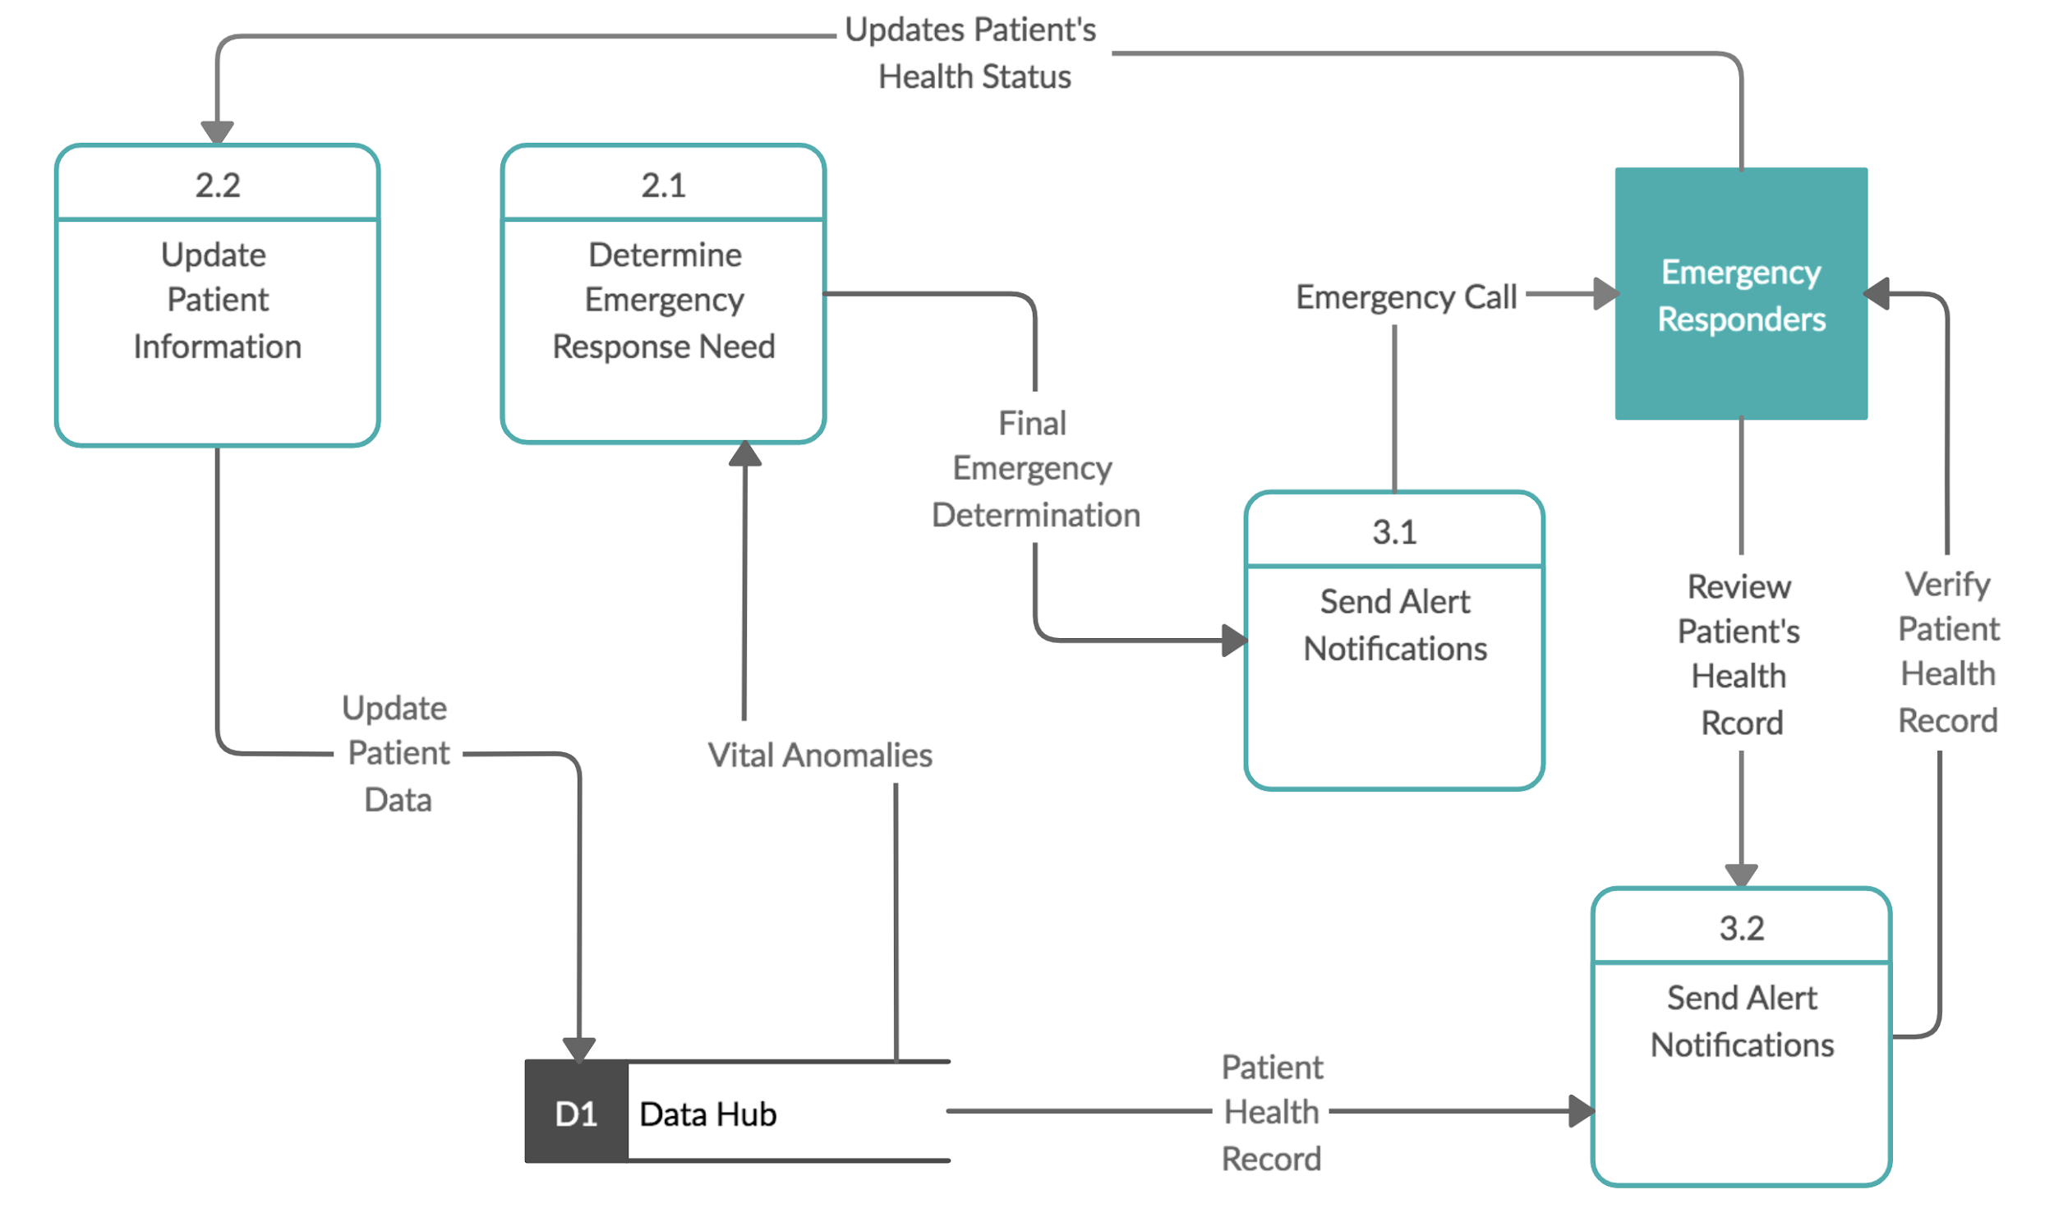
DFD Level 1

Slide 25
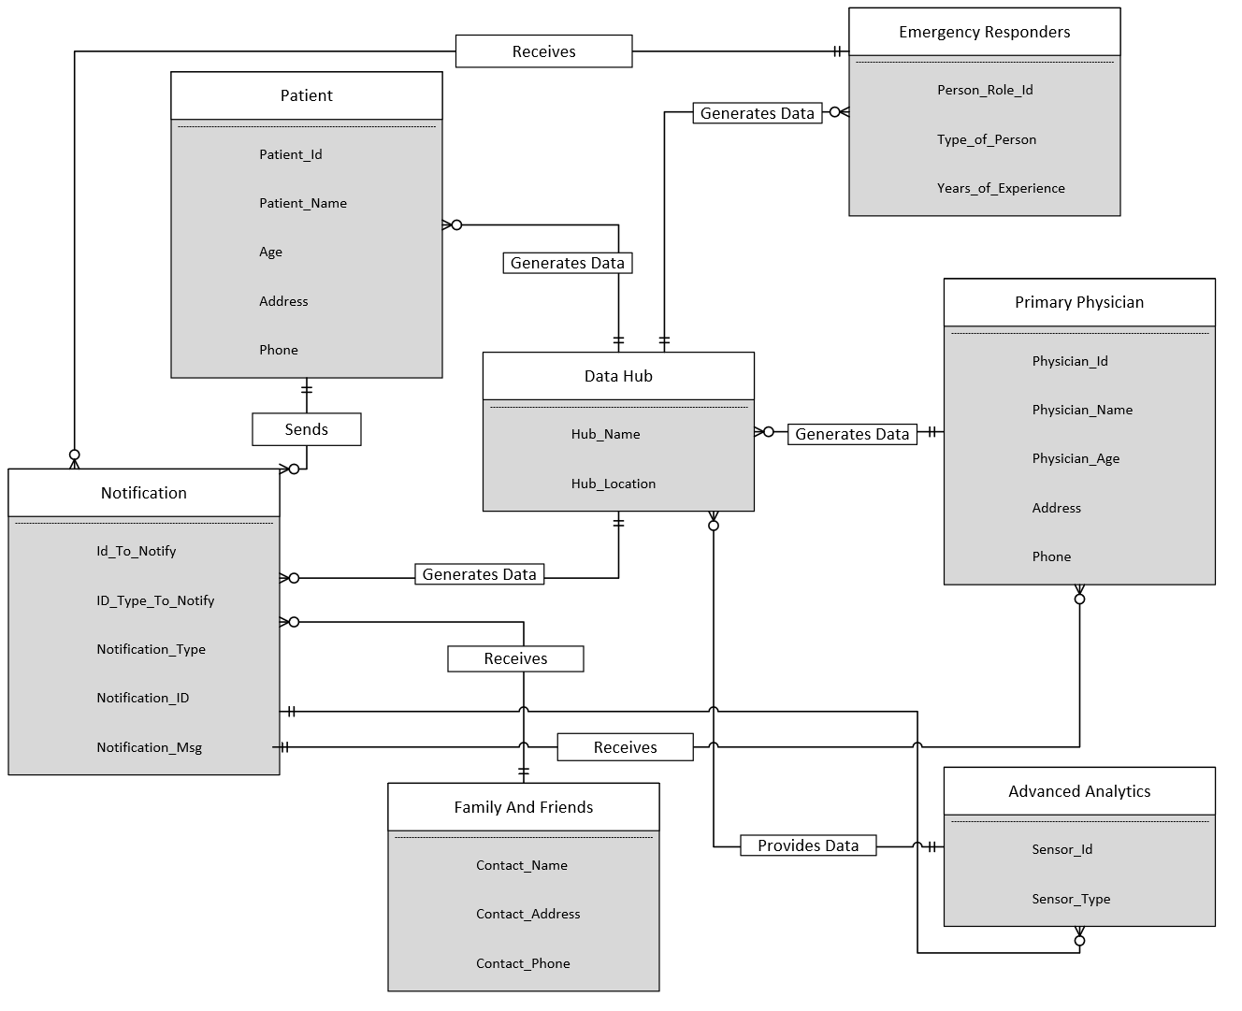
ERD

Slide 26
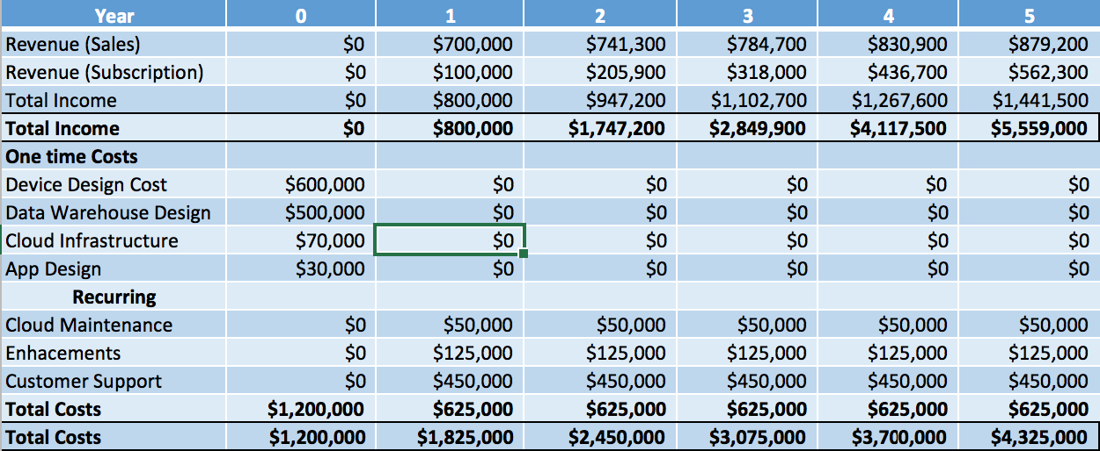
Estimated Income

Slide 27
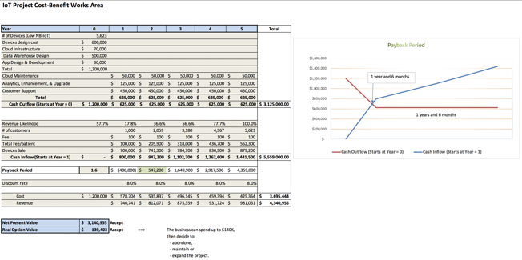
Cost and Monetary Benefits Estimate Details

Slide 28
TMP
The transition to proposed state can broadly be completed in the following steps:
Build a IoT wearable Device to monitor vitals.
Set-up a cloud interface to handle the device traffic.
Build a Data Warehouse to store the data.
Set-up emergency contacts and link them to the wearable device.
Adapt a Data Visualization tool to run Device Analytics.

